Slide 1


Touch

Slide 2
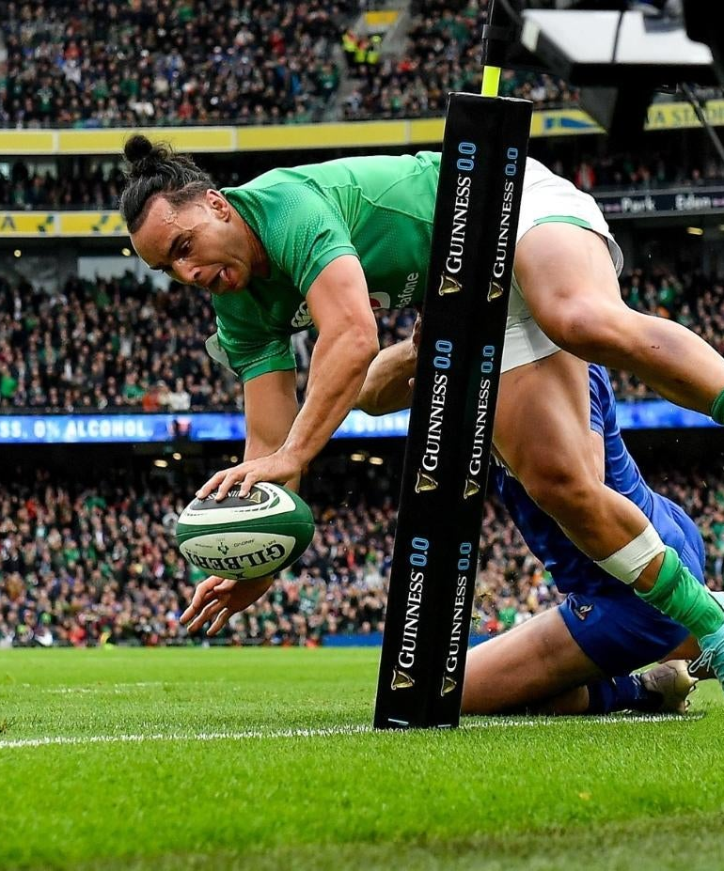

Law 18 Touch, Quick Throw and Lineout
The field of play has side boundaries known as touchlines. When play reaches a touchline, the ball is in touch and becomes dead.
Quick-throws and lineouts are methods of restarting the game with a throw after the ball or
ball-carrier has gone into touch.

Slide 3
The ball is not in touch or touch-in-goal if:
  The ball reaches the plane of touch but is caught, knocked or kicked by a player who is in the playing area.
  A player jumps, from within or outside the playing area, and catches the ball, and then lands in the playing area, regardless of whether the ball reached the plane of touch.
  A player jumps from the playing area and knocks (or catches and releases) the ball back into the playing area, before landing in touch or touch-in-goal, regardless of whether the ball reached the plane of touch.
  A player, who is in touch, kicks or knocks the ball, but does not hold it, provided it has not reached the plane of touch.

Slide 4
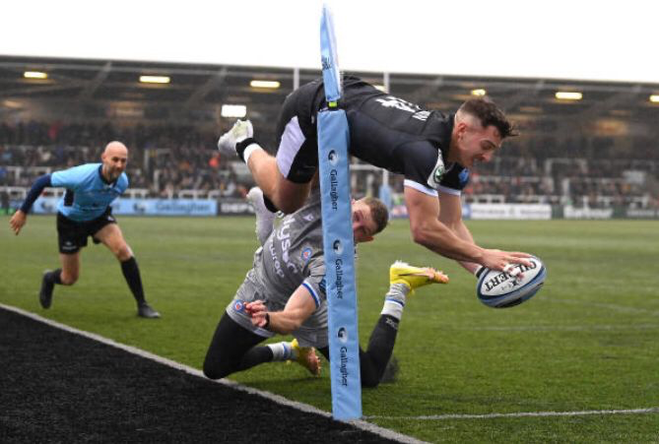
4

Slide 5
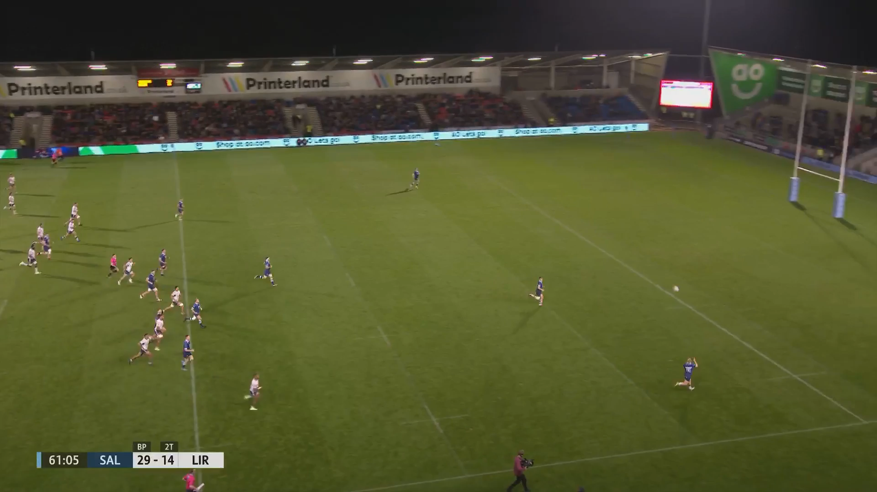
Touch
5

Slide 6
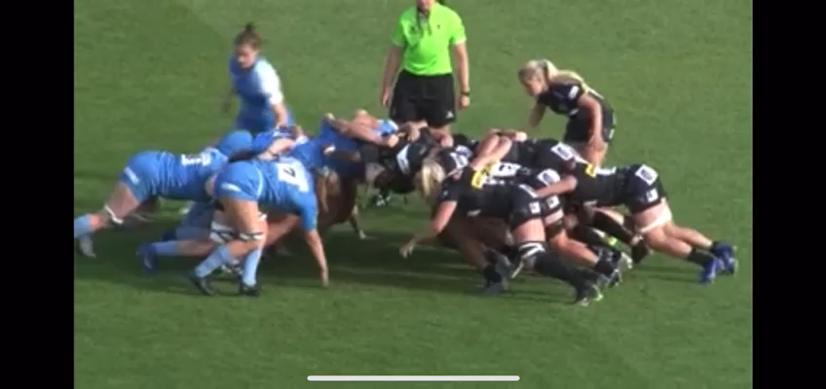

Slide 7
