Slide 1

Mid season MOT

Slide 2
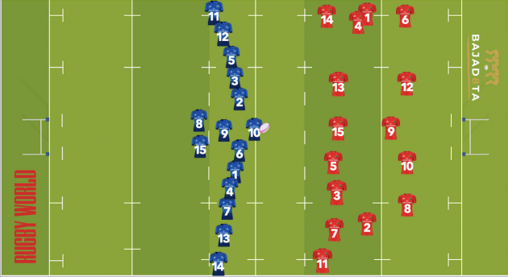
Kick Off

Slide 3
Kick Off
Am I ready to go
Number of players
Have I got touch judges
Are they behind the kicker
Is the kicker behind the line when kicked
Has it travelled 10m

Slide 4
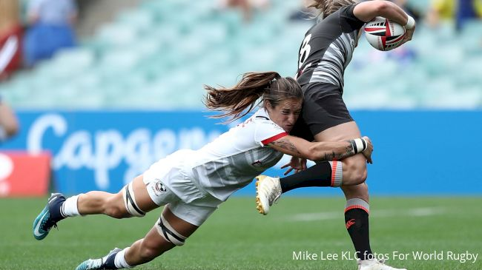
Tackle

Slide 5
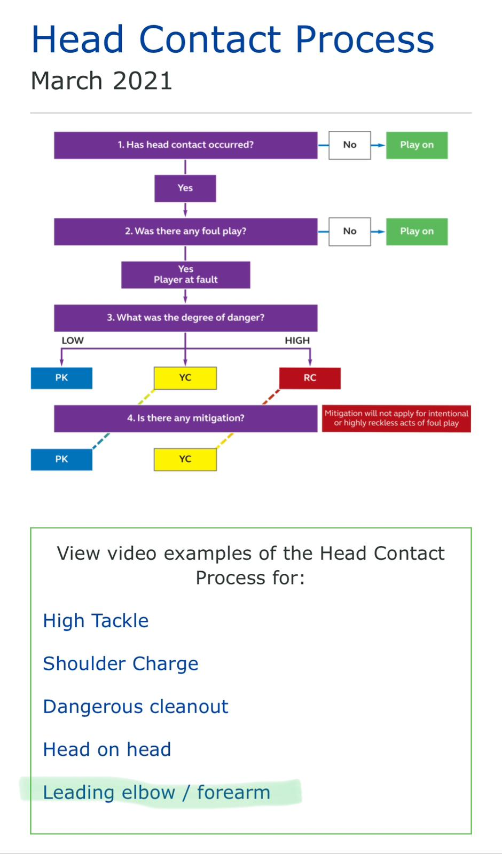
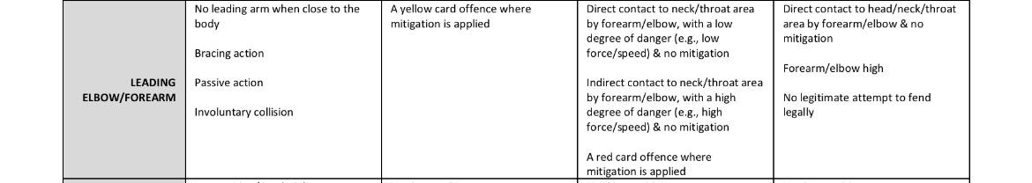
Tackle
Is it legal
If not where are you entering the framework
Have they released?
How's the ball carrier entering the tackle area are they legal
If not where are you entering the framework
What have they done the ball?
Have they taken an extra roll?

Slide 6
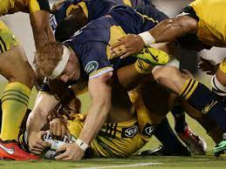
Jackler

Slide 7
Jackler
Are they part of the tackle
Are they supporting their weight
Are they looking to lift the ball
Can they lift it

Slide 8
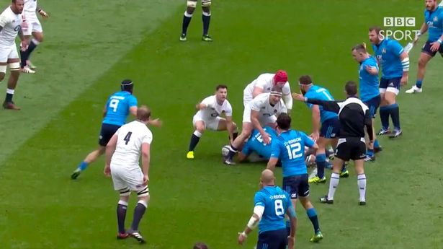
Ruck

Slide 9
Ruck
When is it a ruck?
Where’s the gate
Where are my arriving players coming from?
How are they arriving
When is it over
Wheres the back foot

Slide 10
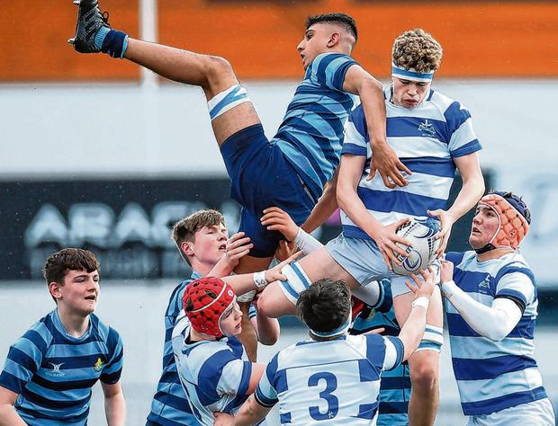
Lineout

Slide 11
Lineout
Can it be taken quickly Y/N
Set up with Space do we have numbers
Is anyone closing the gap?
Is the ball thrown straight?
Do we have contact in the air / hooking of the arms
Are jumpers being thrown across what should we think about if they are?
When is it over?
Offside lines

Slide 12
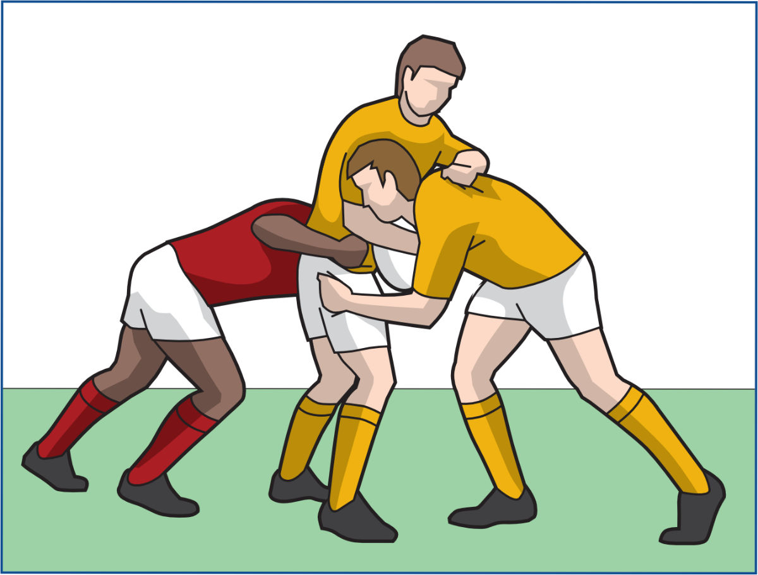
Maul

Slide 13
Maul
When it a maul
What can happen when
What are the defenders doing
What are the attackers doing
Where’s the ball
Is it moving
When has it ended
How did it end
Where the back foot

Slide 14
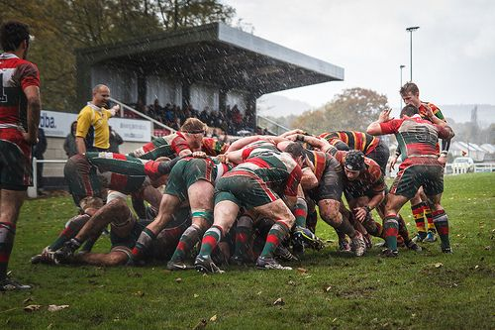
Scrum

Slide 15
Scrum
Set up
Are they straight
Are they stable
Are they holding their weight
What’s the put in like
If the scrum has gone down what caused it
When has the scrum ended

Slide 16
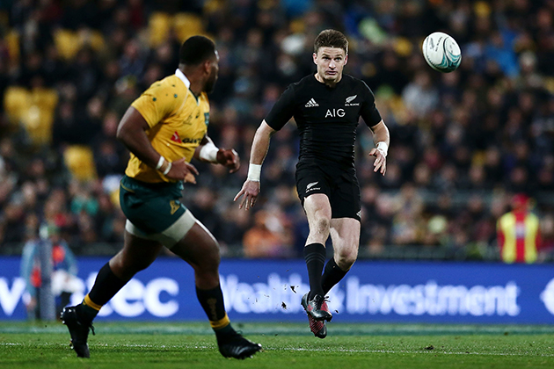
Open field kicks

Slide 17
Open field kicks
Where is it being taken from 50/22? Inside or outside carried back
What happened to the kicker
Who’s onside - Goal hangers
Who can play people onside

